Slide 1
BaseSpace - Manual Regression Testing to Automated Testing
Fanney Zhu
BaseSpace Cloud Test Team

Slide 2
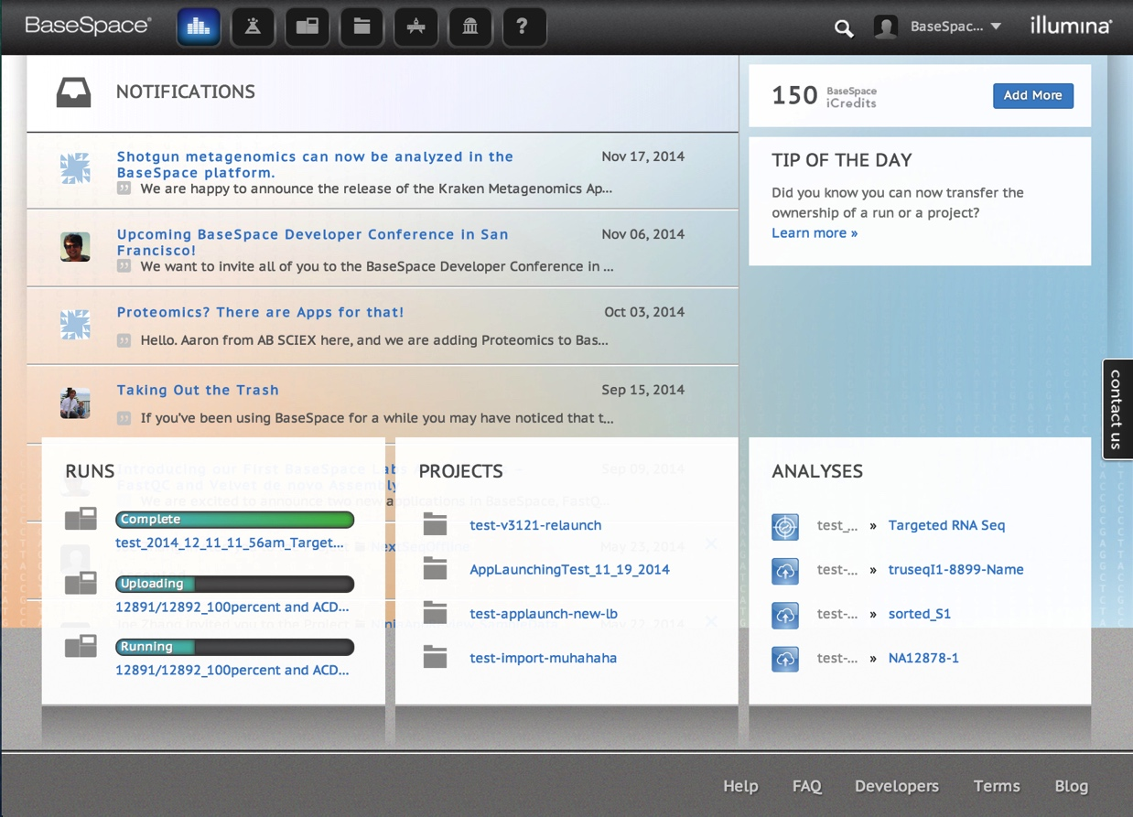
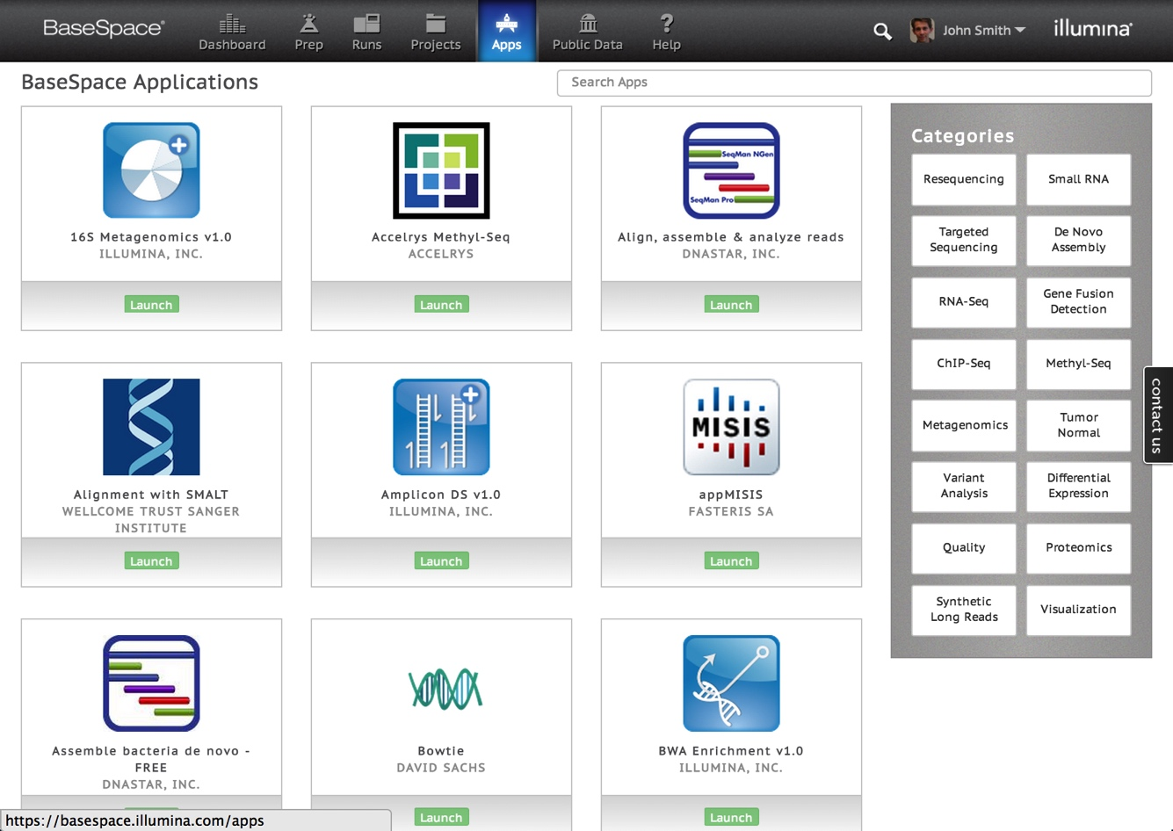
BaseSpace
Illumina’s Cloud Computing Environment
https://basespace.illumina.com/home/index
Notes:
BaseSpace is Illumina’s Genomics Cloud Computing Environment where
scientists can track, store, and analyze sequencing data. With biweekly
releases of new features and bug fixes, software testing is essential for
reducing bugs/defects and optimizing product quality. Due to limited
software test engineers, there has been a long delay between development
and production because of the time invested in manual testing. Automated
testing is the solution for faster turnaround time and continuous delivery.

Slide 3



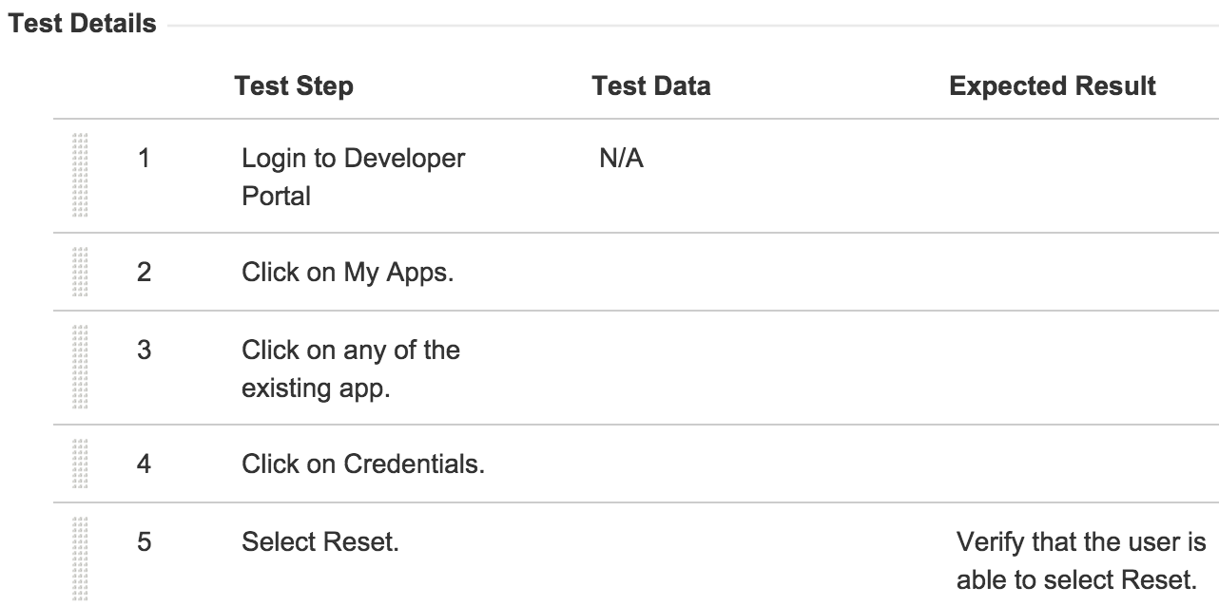



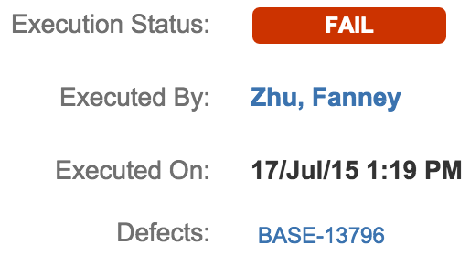
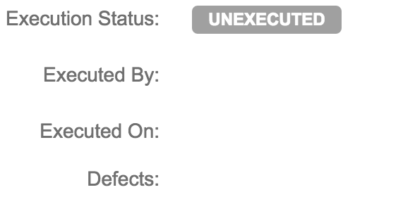
Manual Testing Workflow

Slide 4





Automated Testing Workflow
Notes:
JIRA – defect/bug tracking system
Zephyr – Test management system
Github – source control
Team city
Build to launch on VMs
Trigger run
Zephyr API to JIRA

Slide 5
Statistics
Automated Test Cases: 44
 | Execution Time
Manual Testing | >44 minutes
Automated Testing | 4 minutes 20 seconds

Slide 6
BUT THAT WAS ONLY FOR 1 BROWSER…
Supported Browsers: Safari, Firefox, Chrome, Internet Explorer 10+
 | Execution Time
Manual Testing 4 Browsers | 44 minutes x 4 browsers = 176 minutes
Manual Testing 1 Browser | 44 minutes
Automated Testing n Browsers | ~5 minutes
Notes:
Test automation is fast, reusable and reliable.
Automated testing for 44 test cases takes less than 5 minutes to execute. Even if you could execute one test case per minute manually,
automated testing is still more than 8x faster. To add on, the tests must be ran across different browsers. Automated testing can execute tests
on different browsers in parallel, while manual testing would require testing each browser serially. This results in automated testing across 4
browsers being 35x more efficient than manual testing. With biweekly releases and hence the need for biweekly regression testing, automated
testing can greatly reduce the delay time between development and production, and also allow software testers to focus on tasks that cannot
be automated (i.e. creating new tests cases, bug reporting). Furthermore, automated testing removes human error and ensures that the same
steps are followed through every single time.

Slide 7
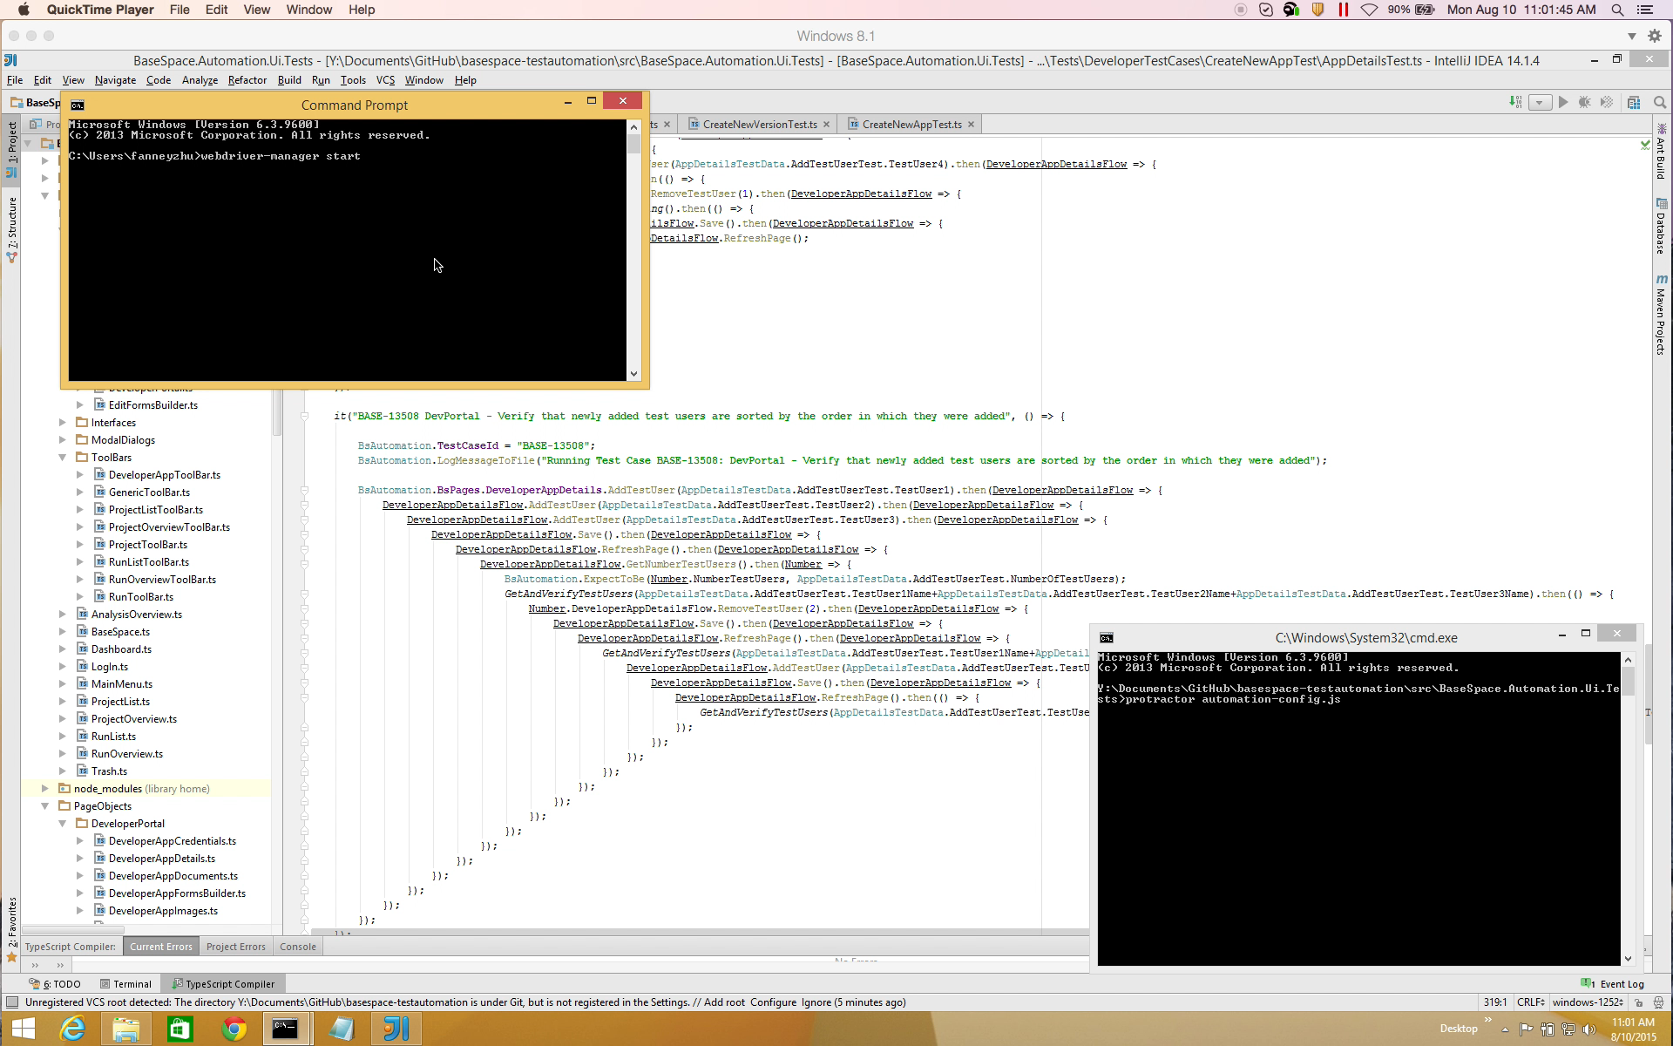
Demo
Notes:
8/10/15 11 AM

Slide 8
Acknowledgements
BaseSpace Team:
Lijun Liu
Long Luc
Andy Ieng
Irish Cancio
Vikas Yadav
Johann Koeh
Nathan Tuong
Josh Tietjen
Stanley Leung
Kyle McNamara
Sree Kodali
Joe Felton
Alice Berengut
Hanzhang Zhu

